Slide 1
The Impact of AR on Lean Manufacturing
Developing a holistic approach to ROI

Slide 2
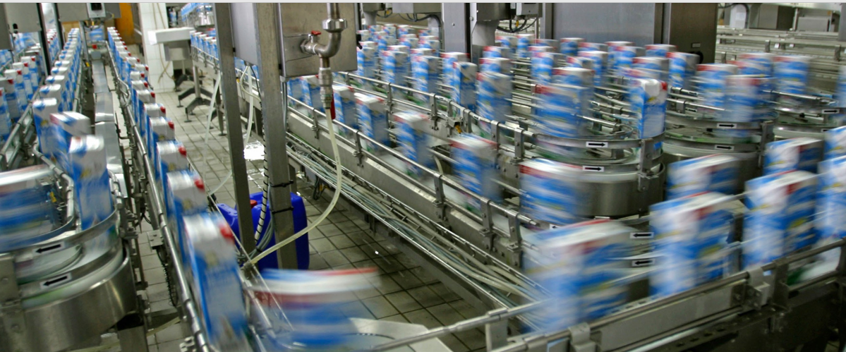
Lean Manufacturing
Lean is:
Eliminating waste wherever possible
Expanding capacity by shortening cycle times and reducing costs
Understanding who the customer is and what is important to them

Slide 3
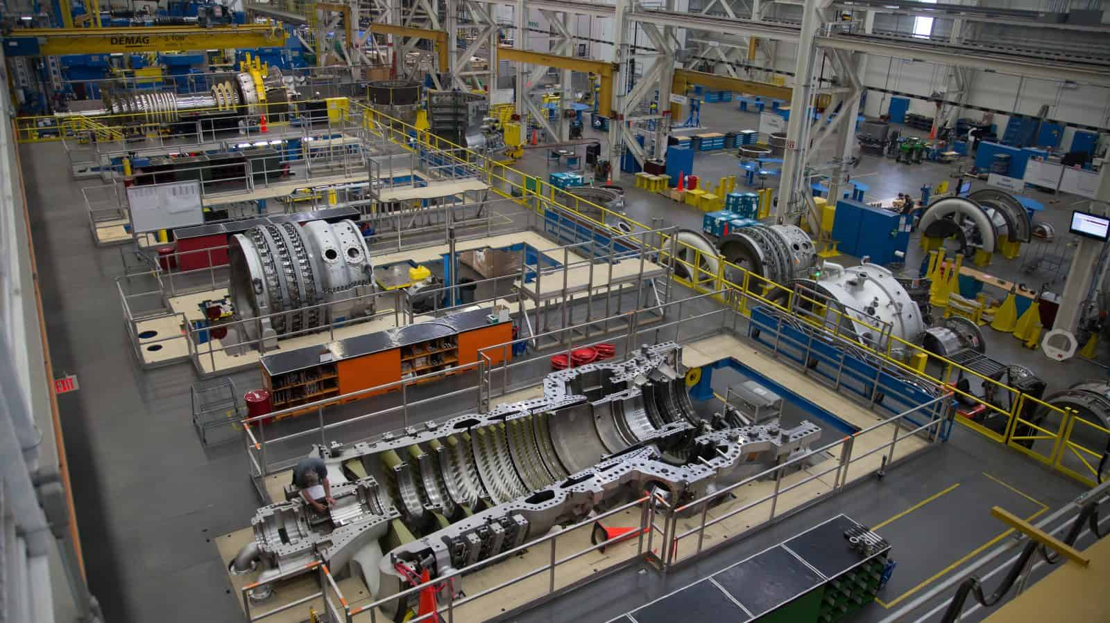
Eliminating Waste
Eight sources of waste:
Defects
Over-production
Waiting
Non-utilized talent
Transportation
Inventory overstocking
Motion
Excess processing

Slide 4
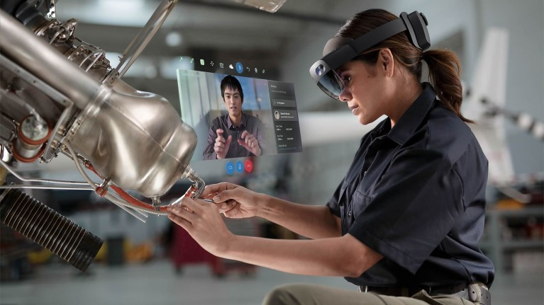
Each waste stream has a distinct ROI
The impact of AR on each waste steam is unique and must be understood distinctly and through interactions.
Notes:
Typically, programs are aligned with one of these waste streams.
Inserting AR is NOT a solution. The process might be

Slide 5
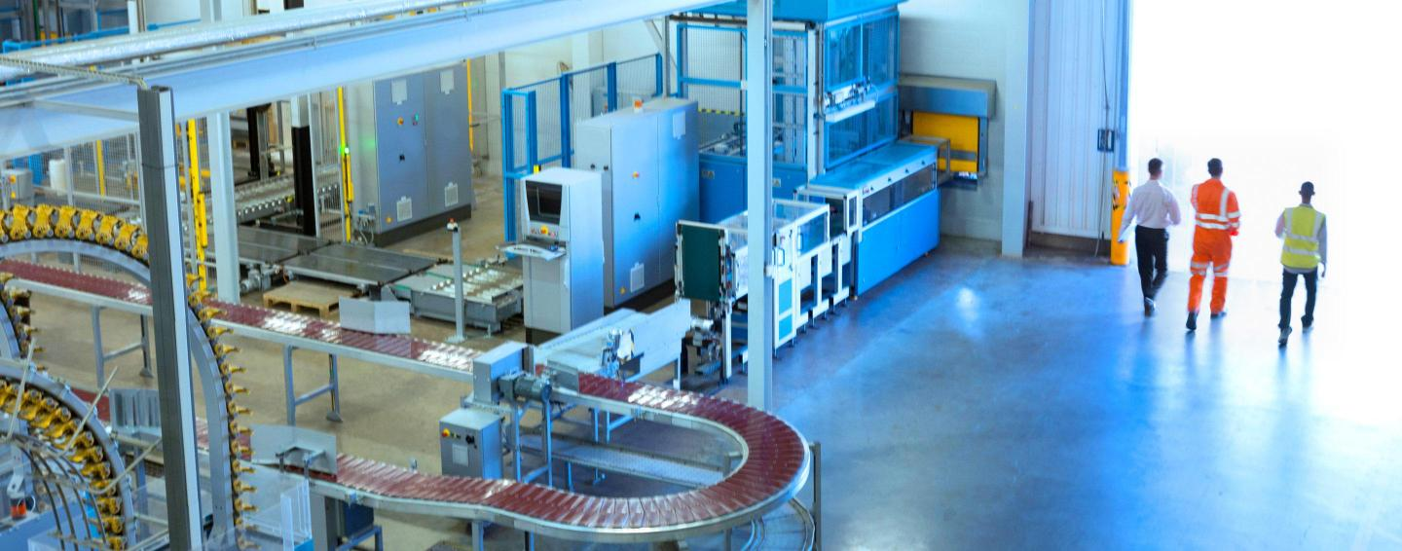
Objectives and scope
Scope:
Examine each waste stream
Through interviews and surveys, understand how AR can impact each stream
Identify synergies
Extend the AREA ROI model to each stream
Develop a report, whitepapers and webcast
Notes:
Leveraging AREA connections, ceramic and glass industries, and SMEs.

