Slide 1
Development of Heuristic Evaluation Checklist for AR Experiences
  Category: Analysis of Software or Hardware
  Barbara S Chaparro, PhD
  Embry-Riddle Aeronautical University
  Daytona Beach, FL

Slide 2

Problem this Research Would Address
There is currently a lack of standards/guidelines for the evaluation of AR solutions
Heuristic Evaluation is a method that has been used in many software domains to identify usability issues
PROBLEM: Standard heuristics need to be developed and validated to allow a range of AR experiences to be evaluated

Slide 3
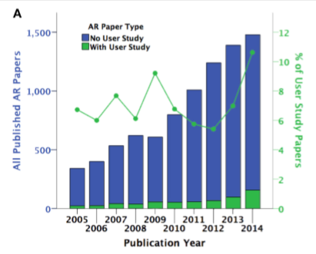
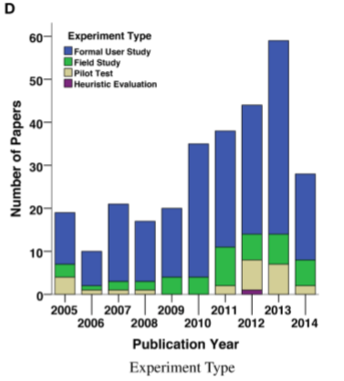
Problem this Research Would Address
Dey, A., Billinghurst, M., Lindeman, R. W., & Swan, J. (2018). A Systematic Review of 10 Years of Augmented Reality Usability Studies: 2005 to 2014. Frontiers in Robotics and AI, 5, 37.

Slide 4
Whose problem would be addressed?
Providers of enterprise wearable AR platforms would be able to more quickly/reliably
  Assess usability and user experience (UX)
  Iterate design/development
  Develop more satisfying, efficient, and effective solutions
Enterprise safety managers would
  Benefit from better designed solutions
Regulatory agencies or groups would
  Appreciate the standardization and overall improvement in quality

Slide 5
How would this research be conducted?
Literature review
  Existing heuristics and guidelines
  Experimental findings
Correlation of AR features to usability/UX attributes and heuristics
Checklist items developed for each heuristic
Validation
  Experts
  Users with AR experiences
Refinement

Slide 6
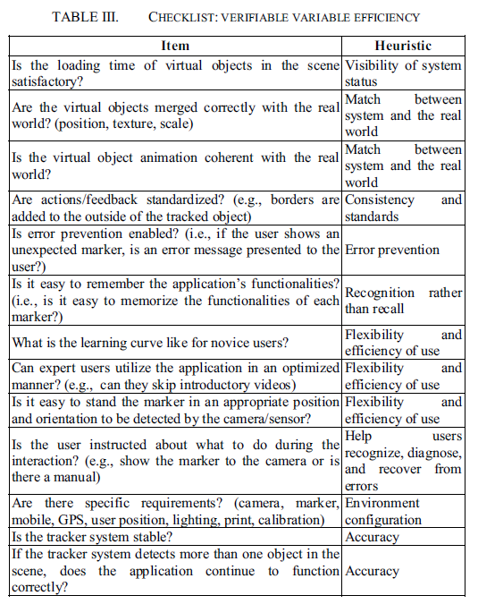
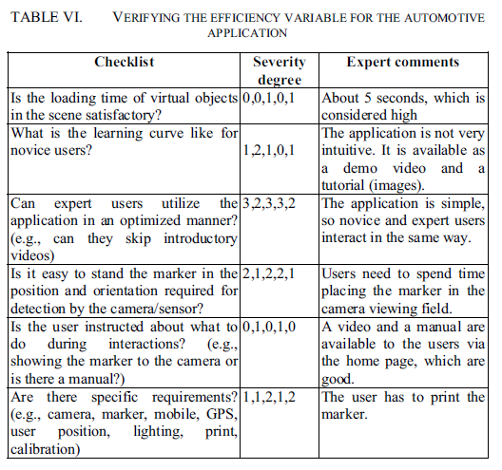
How would this research be conducted?
de Paiva Guimarães, M., & Martins, V. F. (2014, May). A checklist to evaluate Augmented Reality Applications. In 2014 XVI Symposium on Virtual and Augmented Reality (pp. 45-52). IEEE.

Slide 7
How would this research be conducted?
Areas to Consider:
User interface design of AR components
  Contrast/legibility on variety of backgrounds
  Affordance
  Consistency
  Location of AR elements
Comfort of device
Alignment between physical and virtual environments
Ease of interaction
Etc…

Slide 8
How would this research be conducted?
Deliverables
Literature review white paper
Validation results & discussion white paper
Final heuristic checklist(s)

Slide 9
Benefits to AREA Members
AREA members will be able to more quickly assess the usability/UX of emerging AR experiences
Long term impacts of this research:
  Increased user focus in development
  Improved usability/UX solutions
  Increased user satisfaction and acceptance of AR technology

